Slide 1
Public Retirement Benefits:
Options for the Future
Legislative Analyst’s Office
www.lao.ca.gov

Slide 2
Key Principles
Retirement Benefits Are Just a Part of Overall Employee Compensation.

Slide 3
Key Principles
Encouraging Retirement Savings—Through Deferral of Some Compensation—Is Good Policy.

Slide 4
Key Principles
A Well-Managed and Properly Funded Retirement System, Therefore, Is a Good Thing.

Slide 5
Overview
Retirement Funding Basics
Perspectives on State Retirement Costs
Problems in the Current System
Options to Address These Problems
The Legislature’s Role

Slide 6
Retirement Funding Basics
California Governments and Public Employees Pay Pension “Normal Costs” Each Year.
  Normal costs: funds that need to be set aside and invested now to cover all future costs of benefits that employees earn this year.

Slide 7
Retirement Funding Basics
California Governments and Public Employees Generally Do Not Pay Retiree Health “Normal Costs” Each Year.
  Retiree health costs are paid on a pay-as-you-go basis. Generally, there are no investment returns to offset the employer and retiree shares of health costs.

Slide 8
Retirement Funding Basics
Unfunded Liabilities…
  …the additional amount that would need to be deposited today and invested over time in order to pay all future benefits earned to date by retirement system members.

Slide 9
Retirement Funding Basics
Unfunded Liabilities Emerge Even When Normal Costs Are Paid Each Year…
  …due to investment returns that fail to meet the pension system’s annual target.
  …due to changing demographics.
  …due to increases in benefits applied to years already worked (“retroactive” increases).

Slide 10
Retirement Funding Basics
Over the Long Term, CalPERS and Some Other Systems Have Generated Average Annual Returns of 7 Percent and More.
  Some assert that system valuations should assume 3 percent or 4 percent returns in the future.
  These analyses probably overstate systems’ funding problems substantially.

Slide 11
Retirement Funding Basics
Facts About California Pension Systems’ Unfunded Liabilities:
  They often are huge.
  They do not have to be paid off immediately, but instead over time—like a debt obligation.
  They are a major contributor to recent—and future—pension contribution increases.

Slide 12
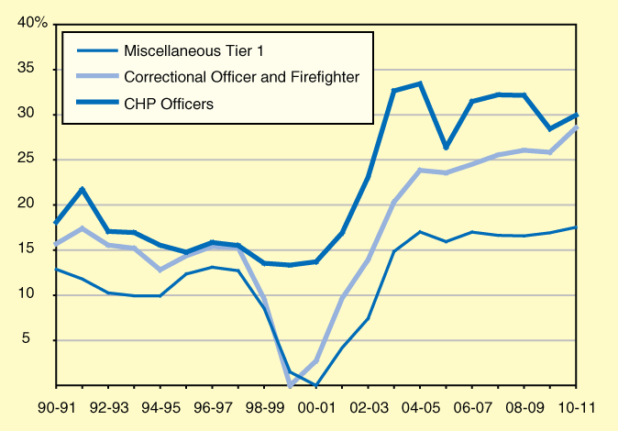
State Retirement Costs
Have Been Growing
Pension Contributions as Percent of Payroll

Slide 13
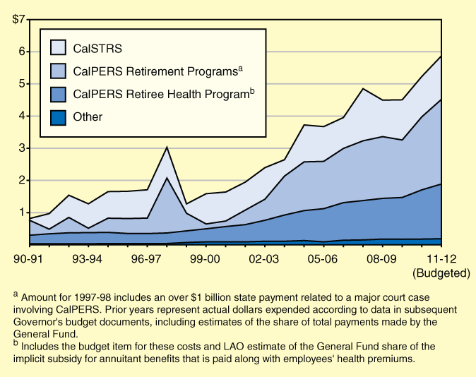
State Retirement Costs
Have Been Growing
General Fund (In Billions)

Slide 14
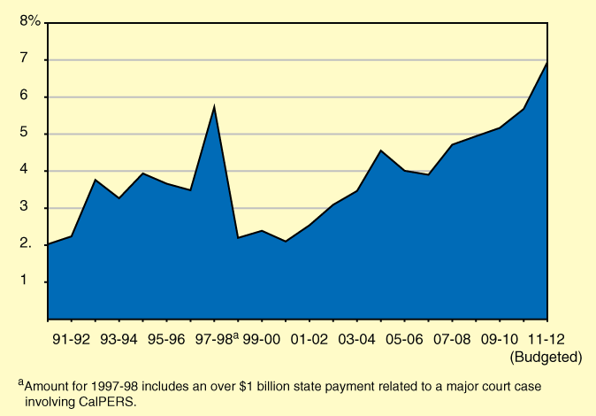
State Retirement Costs
Have Been Growing
Percent of General Fund Expenditures

Slide 15
Problems With the Current System
Tendency Not to Fully Fund Costs as They Accrue…
  Retiree health.
  Retroactive benefit increases.
  Excessive optimism about future investment returns.

Slide 16
Problems With the Current System
…Defers Costs to Future Generations.
  Through “rate stabilization,” some pension systems have opted to defer cost increases to future years (future decades in some cases).
  Current system virtually guarantees rising cost trends for the foreseeable future.

Slide 17
Problems With the Current System
Inflexible Benefits…Despite the Need for State and Local Fiscal Flexibility.
  California case law very protective of benefits under the current structure.
  Often unclear what, if any, aspects of the benefits that governments can modify.

Slide 18
Problems With the Current System
Employers—and Taxpayers—Bear Almost All of the Financial Risk.
  When unfunded liabilities emerge or normal costs rise, employee contributions generally remain fixed.
  Employer costs, however, rise.

Slide 19
Problems With the Current System
Employer Costs Subject to Considerable Volatility.
  In late 1990s, pension systems cut employer contributions to near zero based on short-term investment gains…
  …then, increased them substantially….
  …just when governments faced their own budget problems.

Slide 20
Problems With the Current System
Our Defined Benefits Are Very Generous…
  …compared to those in other states.
  …compared to the increasingly non-existent defined benefit systems in the private sector.

Slide 21
Problems With the Current System
We Doubt That the Substantial Disparity Between Public- and Private-Sector Retirement Benefits Can Be Sustained Much Longer.
There Are Reasonable Options to Address These Problems.

Slide 22
Options for the Future
New Models for Public Retirement Programs for Future Employees.
  Defined benefit programs with more cost sharing—when costs rise, both employer and employee contributions rise.
  Employer contributions to both a defined contribution and a less generous defined benefit program (“hybrid program”).

Slide 23
Options for the Future
Advantages of More Employee Cost Sharing.
  Greater understanding of true costs of benefits for workers and employers alike.
  Makes employees less likely to seek unsustainably high benefits.
  Encourages greater fiduciary care by retirement boards.

Slide 24
Options for the Future
Advantages of Hybrid Programs:
  Employer continues to help employees save for retirement.
  Employees still receive tax benefits.
  Large unfunded liabilities less likely.
  Employer cost liability reduced.

Slide 25
Options for the Future
End Retroactive Retirement Benefit Increases.
  No exceptions.
  Benefits can only be increased for future years of service.

Slide 26
Options for the Future
Pay Costs as They Accrue.
  No exceptions.
  No substantial reductions in employer and employee contributions unless system is substantially “overfunded” for multiple years.
  No “payment holidays” ever…some level of contributions required each year.
  Need to start paying retiree health normal costs by 2020.

Slide 27
Options for the Future
Much Greater Clarity About Employer Obligations.
  From the moment employees are hired, need to be crystal clear about which retirement benefits can be modified and which cannot.

Slide 28
The Legislature’s Role
For CalPERS and Local Pension Benefits…
  Approve laws or MOUs creating hybrid or cost-sharing programs for future state employees.
  Approve laws requiring CalPERS and other systems to offer such programs for local agencies.
  Existing unfunded liabilities already being paid through annual contributions to the system.

Slide 29
The Legislature’s Role
For State Retiree Health Benefits…
  Approve laws to give state more flexibility to change retiree health benefits for future employees.
  No idea what health care will be like 30 to 40 years from now when they retire.
  Changes in pension benefits will tend to increase retirement age…thereby reducing future retiree health costs.

Slide 30
The Legislature’s Role
For CalSTRS Pension Benefits…
  Approve laws to implement hybrid or cost-sharing programs for future employees.
  Future employees’ benefits should be funded entirely from district and teacher contributions.
  State probably will need to make payments for many years to retire existing unfunded liabilities.

Slide 31
The Legislature’s Role
For UC Pension Benefits…
  State probably will need to contribute additional state funds in the future.
  Additional contributions should be made contingent on comparable pension system changes as those made for state and school employees.

Slide 32
LAO Bottom Line
State Should Encourage Retirement Savings by Public Employees.
Current System Is Too Expensive and Too Inflexible.
Goal Should Be to Preserve Robust Public Retirement Systems That More Closely Resemble Those of Other Californians.

