Slide 1
State Budget Update
California Association of
School Business Officers
April 14, 2016

Slide 2
State Budget

Slide 3
Governor’s Budget Expenditures
(Dollars in Millions)

Slide 4
Reserve Under Governor’s Budget Plan
(In Millions)

Slide 5
Constitutional Spending Requirements
Reserves
Proposition 2 Debt Payments
Proposition 98

Slide 6
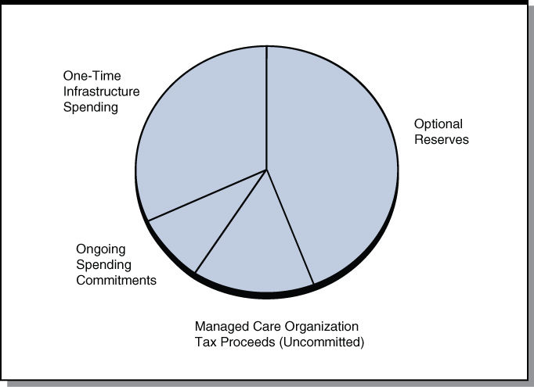
Discretionary Spending Proposals

Slide 7
State Revenue Update
2014-15 Revenues
Might increase hundreds of millions due to accruals.
2015-16 Revenues
Big Three tax revenues are $103 million above projections through March.
Corporate tax: $359 million above projections.
Personal income tax: $124 million below projections.
Sales tax: $132 million below projections.

Slide 8
Key Factors for 2016-17
Stock Market
Growth in Bay Area
Growth in Global Economy

Slide 9
May/June Budget Planning
Small Increase in State Revenue
Small Non-Education Cost Increases to Account for New Minimum Wage Law
Small Additional Spending on Non-Education Programs

Slide 10
Education Budget

Slide 11
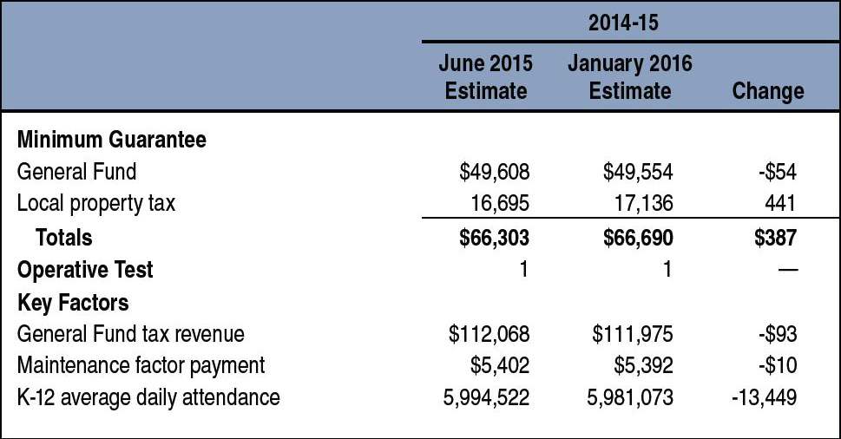
2014-15 Minimum Guarantee
(Dollars in Millions)

Slide 12
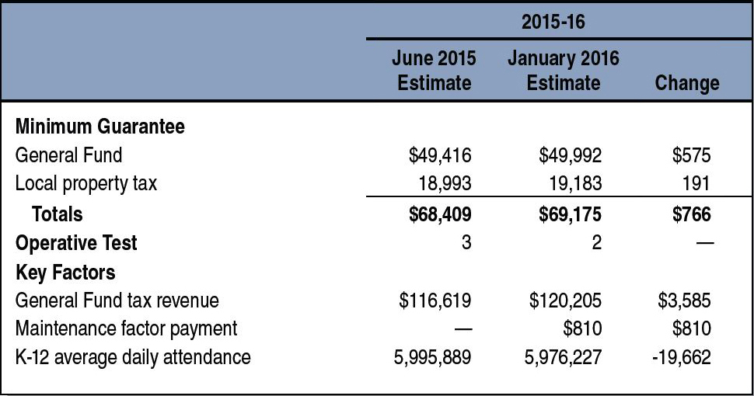
2015-16 Minimum Guarantee
(Dollars in Millions)

Slide 13
2016-17 K-12 Funding
(Dollars in Millions)

Slide 14
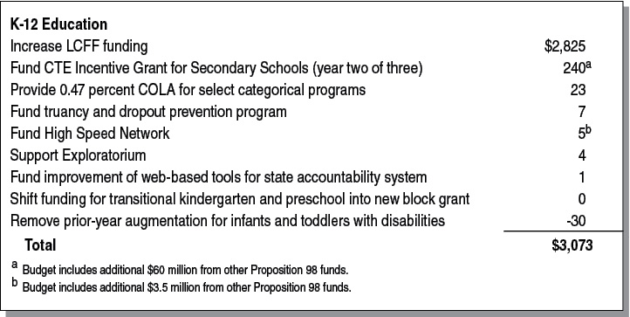
2016-17 K-12 Changes
(In Millions)

Slide 15
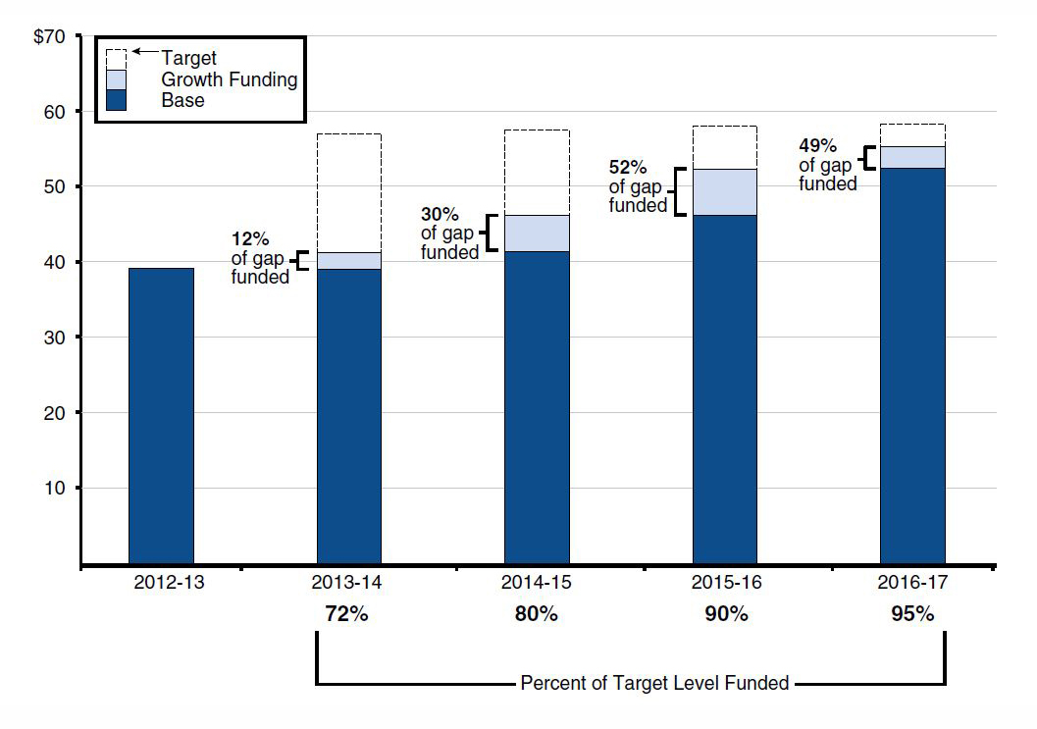
Local Control Funding Formula
(Dollars in Billions)

Slide 16
May/June Budget Planning
Small Spending Adjustments
Likely Emphasis on One-Time Spending
A Few Legislatively Driven Spending Decisions

Slide 17
Proposition 98 Property Tax Estimates
Reflects Governor’s Budget (Dollars in Millions)

Slide 18
Issues With Specific Proposition 98 Proposals
Preschool
Education Mandates Backlog
Education Mandates Block Grant
County Offices of Education Funding
Special Education

Slide 19
Other Issues
Proposition 30 Tax Extension
School Bond
CalSTRS and CalPERS Cost Increases
State School Deposit/Local Reserve Caps

