Slide 1
Budget Outlook for California School Districts
Legislative Analyst’s Office
Presented to: California Society of Municipal Analysts
August 15, 2013
www.lao.ca.gov

Slide 2
Proposition 98 Funding

Slide 3
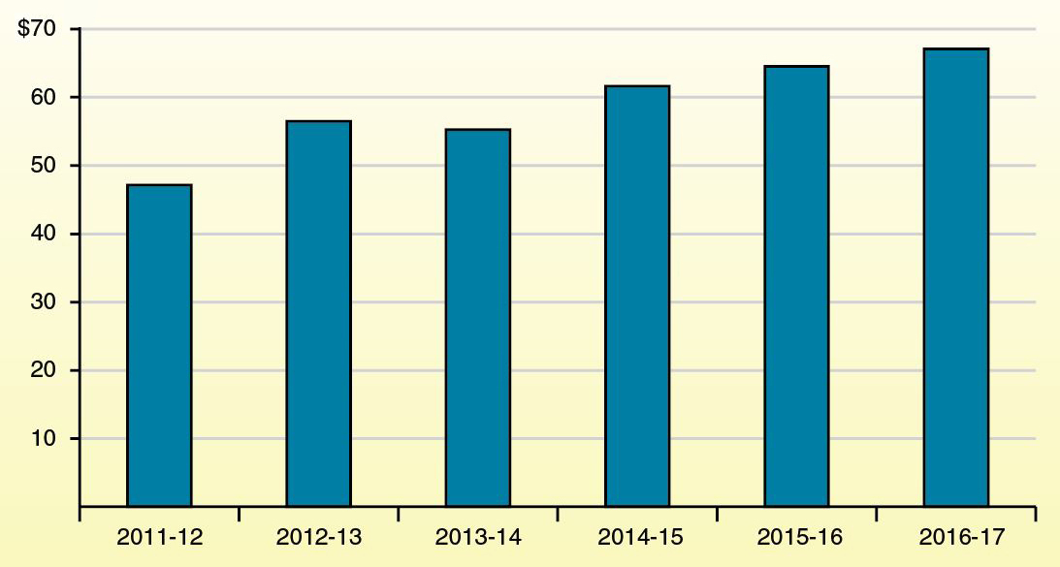
Forecast of Proposition 98 Minimum Guarantee
In Billions

Slide 4
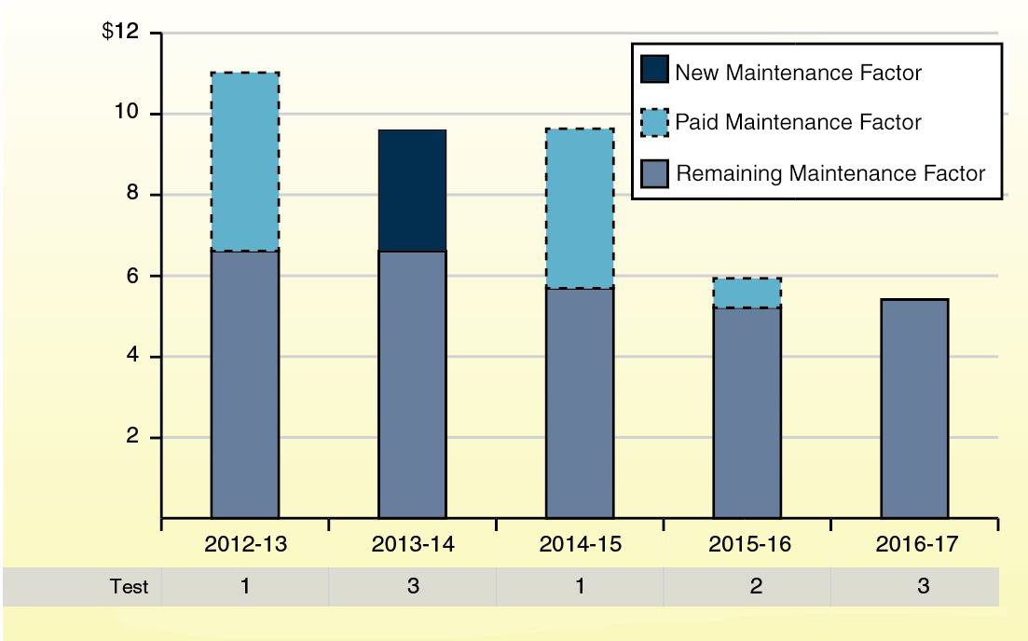
Forecast of Proposition 98 Maintenance Factor Obligation
In Billions

Slide 5
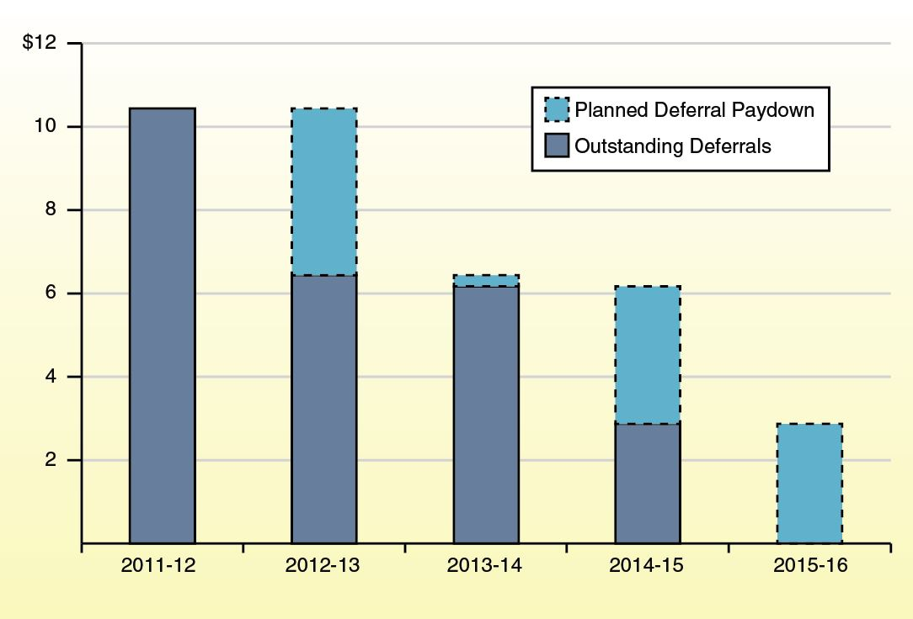
Governor's Plan to Eliminate Payment Deferrals
In Billions

Slide 6
Local Control Funding Formula (LCFF)

Slide 7
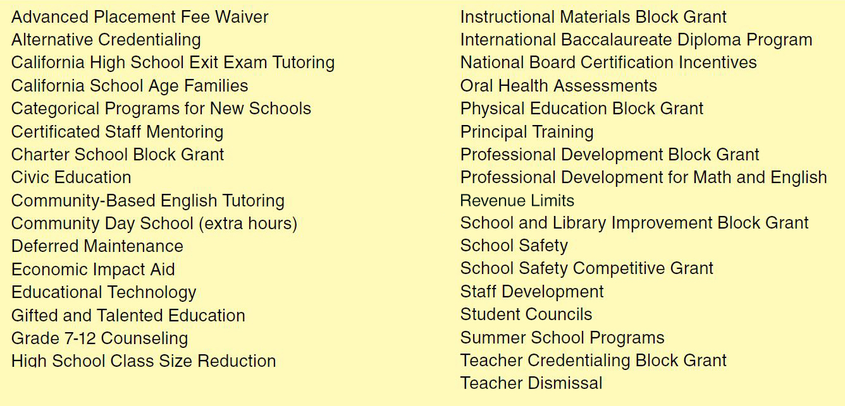
State Programs Eliminated Under New Funding System

Slide 8
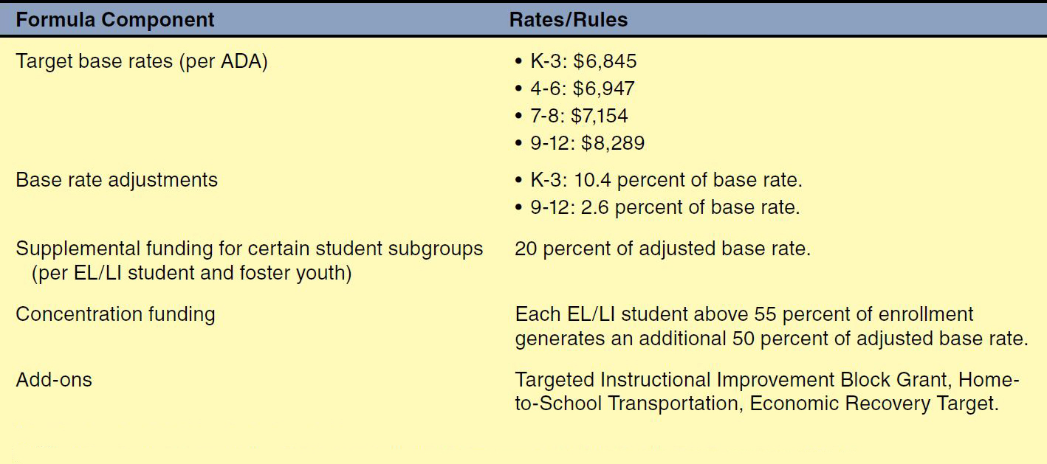
Overview of LCFF

Slide 9
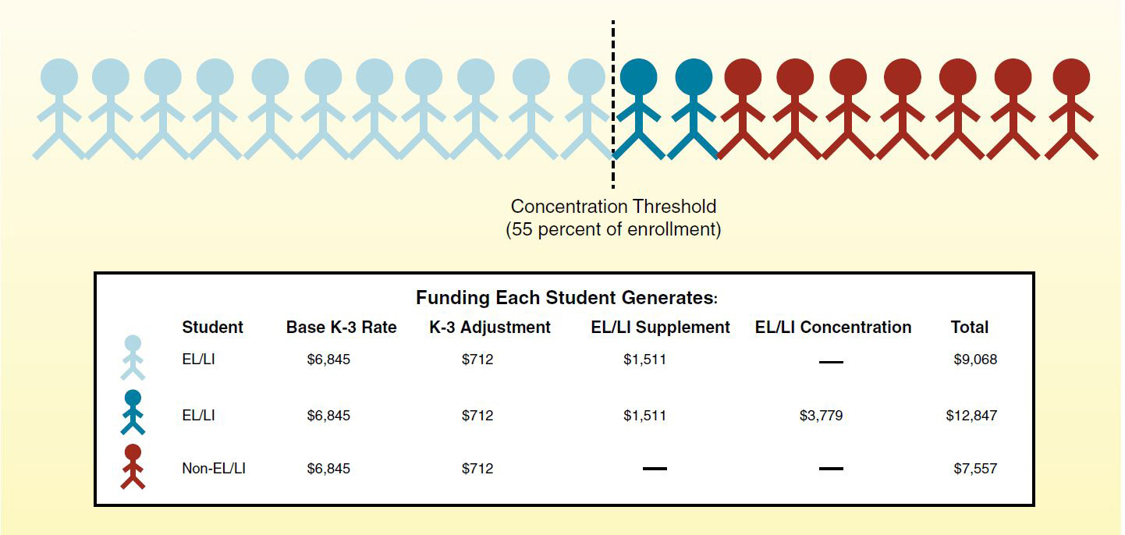
Illustration of How LCFF Works

Slide 10
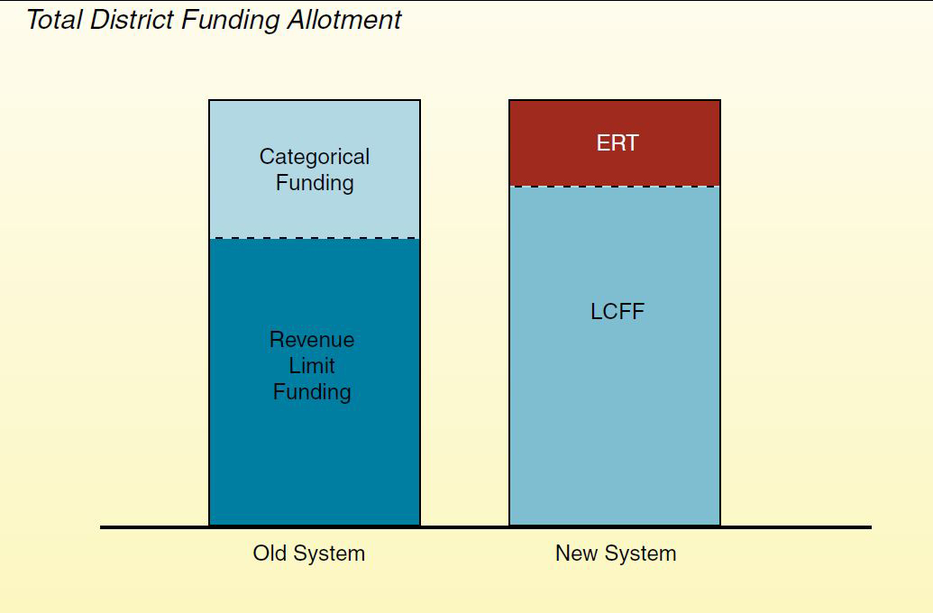
Economic Recovery Target (ERT)

Slide 11
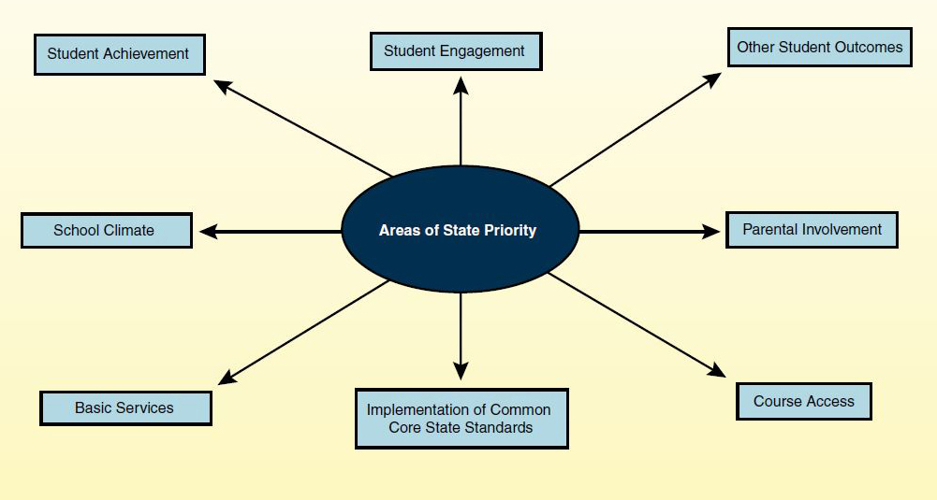
Local Control and Accountability Plans (LCAPs)

Slide 12
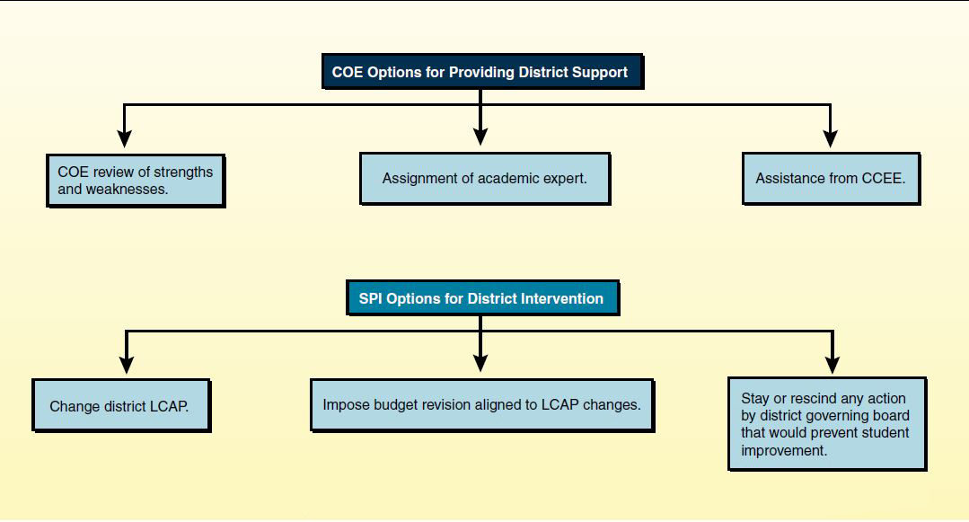
New System of School District Support and Intervention

Slide 13
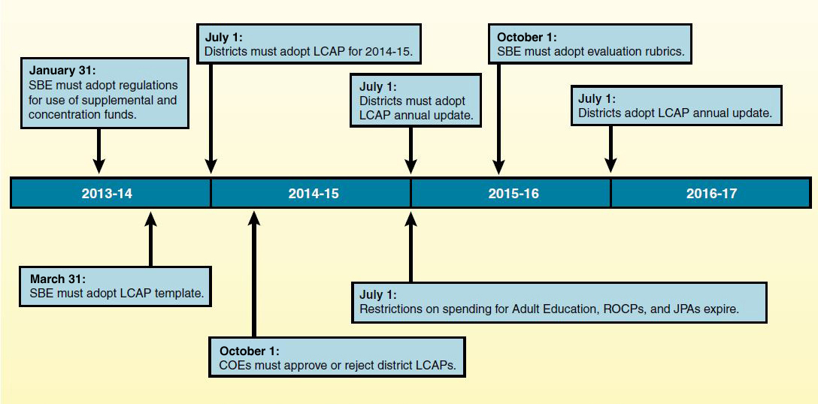
Implementation Timeline

