Slide 1
California’s Fiscal Outlook
Legislative Analyst’s Office
California Association of School Business Officials Annual Conference
April 4, 2013
www.lao.ca.gov

Slide 2
Budget Overview

Slide 3
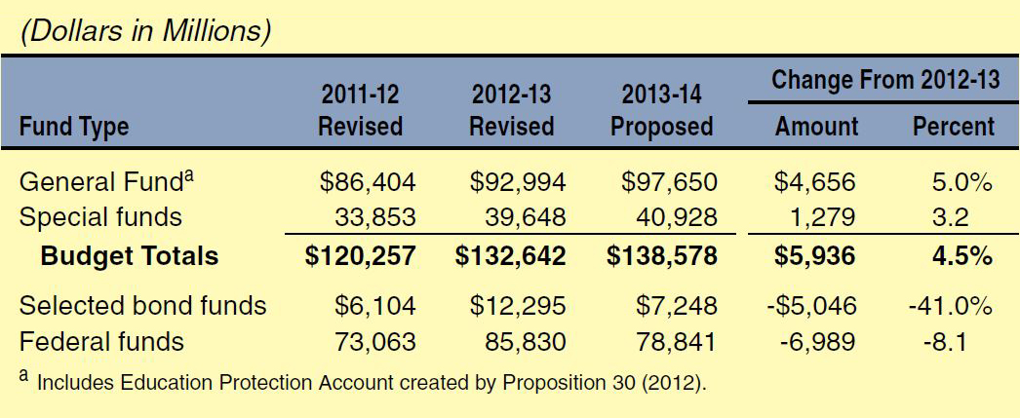
Total State Expenditures

Slide 4
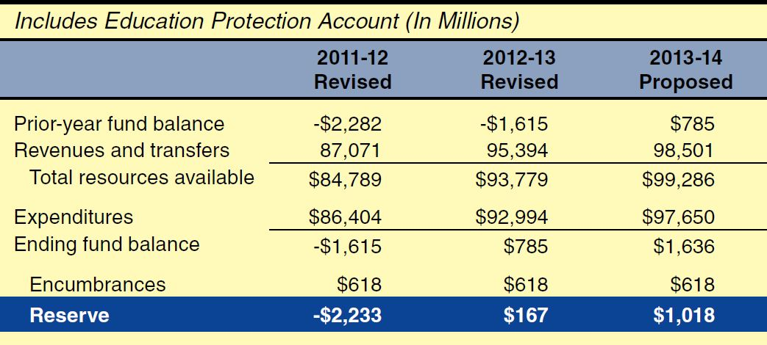
State General Fund Condition

Slide 5
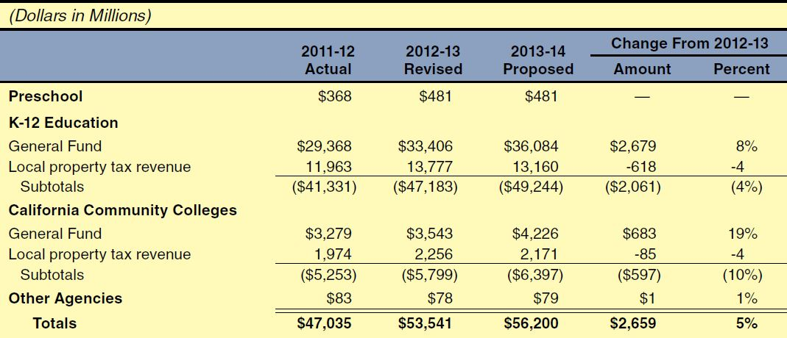
Proposition 98 Funding

Slide 6
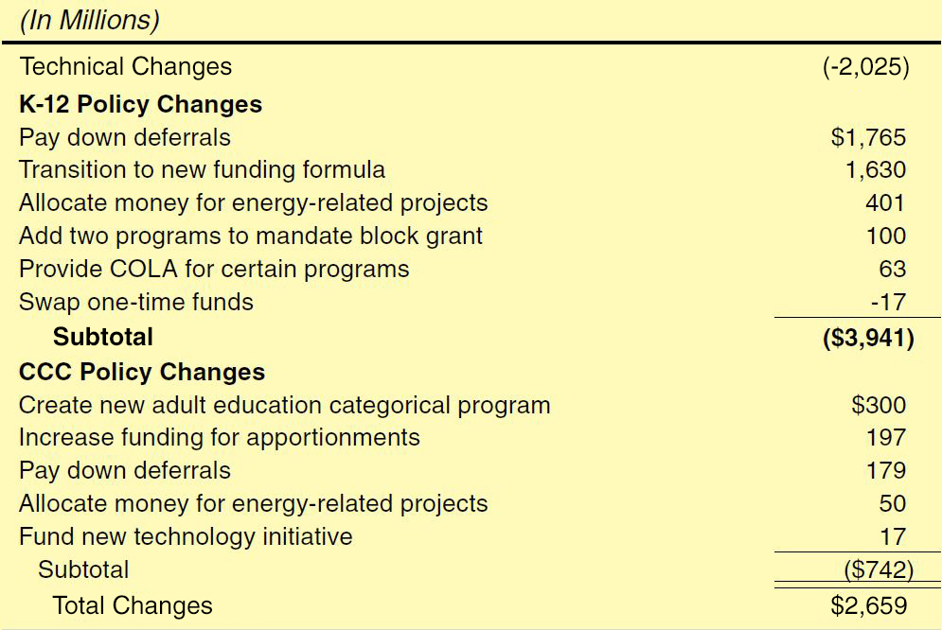
Proposition 98 Spending

Slide 7
Governor’s Multiyear Paydown Plan

Slide 8
Economic Update

Slide 9
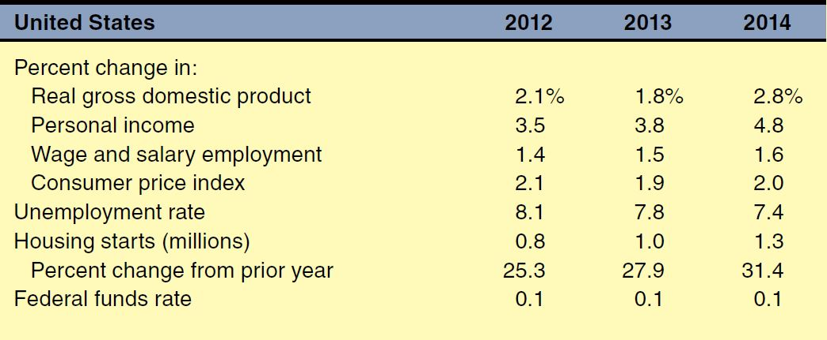
Administration's January 2013 National Economic Forecast

Slide 10
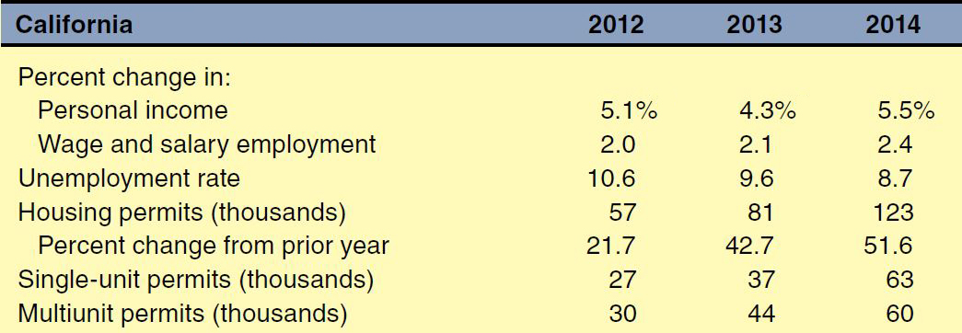
Administration's January 2013 State Economic Forecast

Slide 11
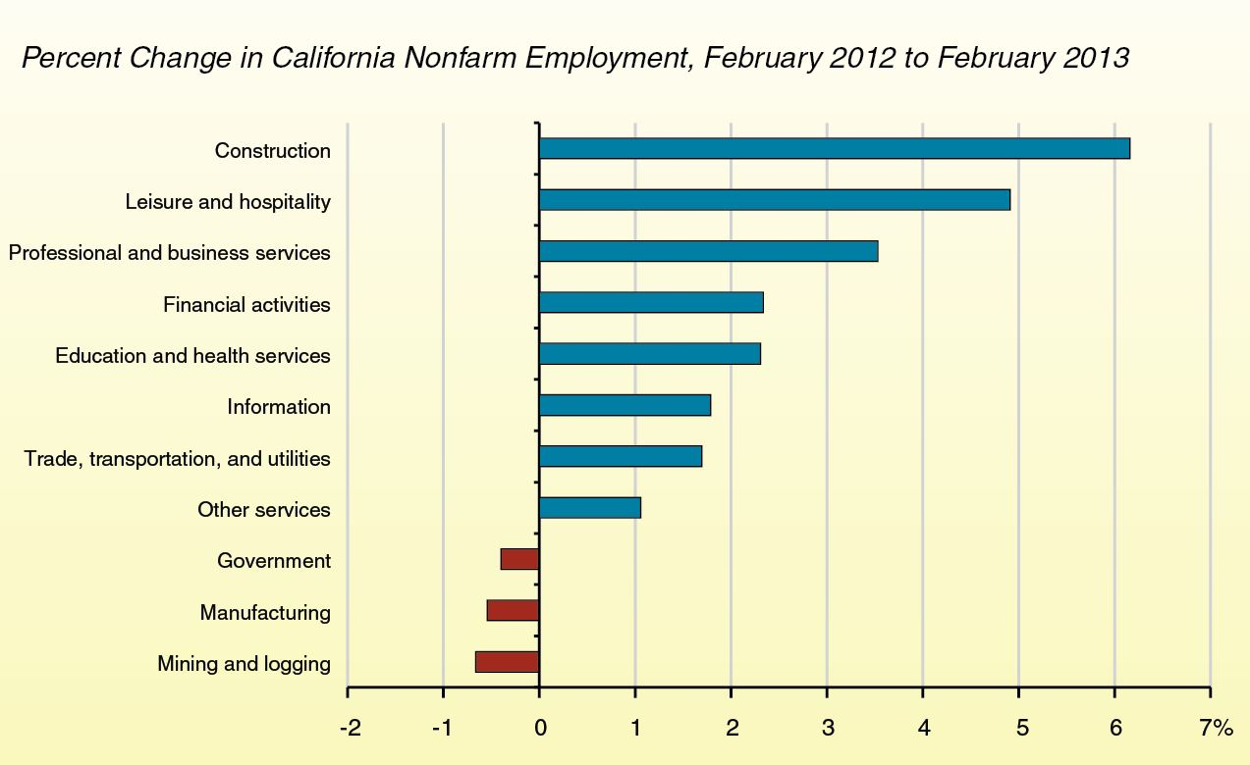
Some Industry Sectors Continue to Struggle

Slide 12
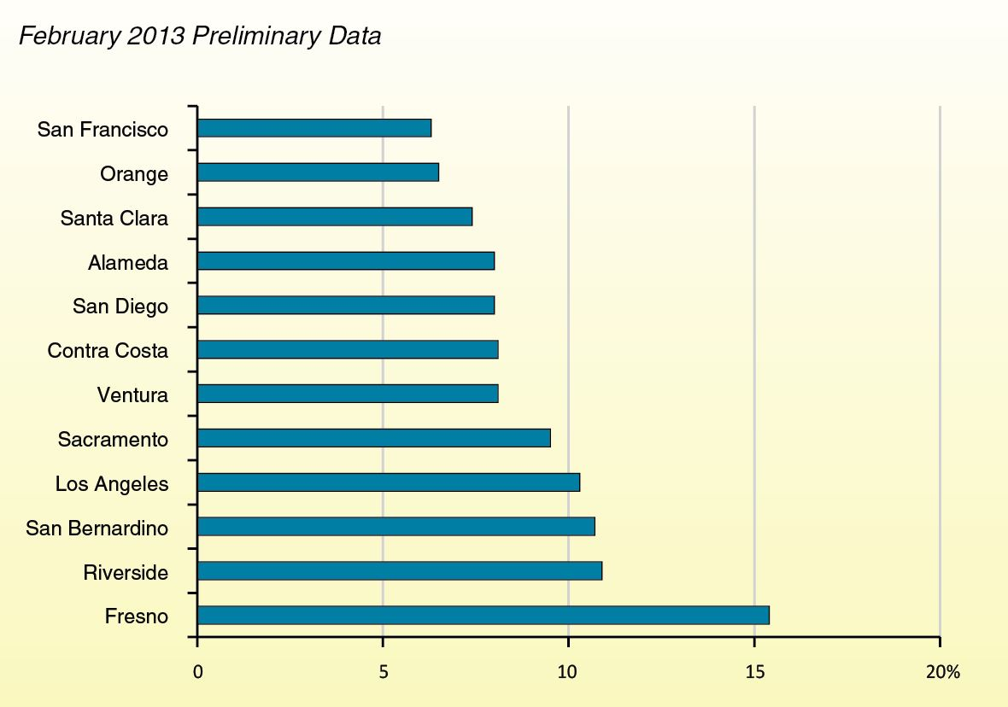
Unemployment Rate Varies Widely Among Counties

Slide 13
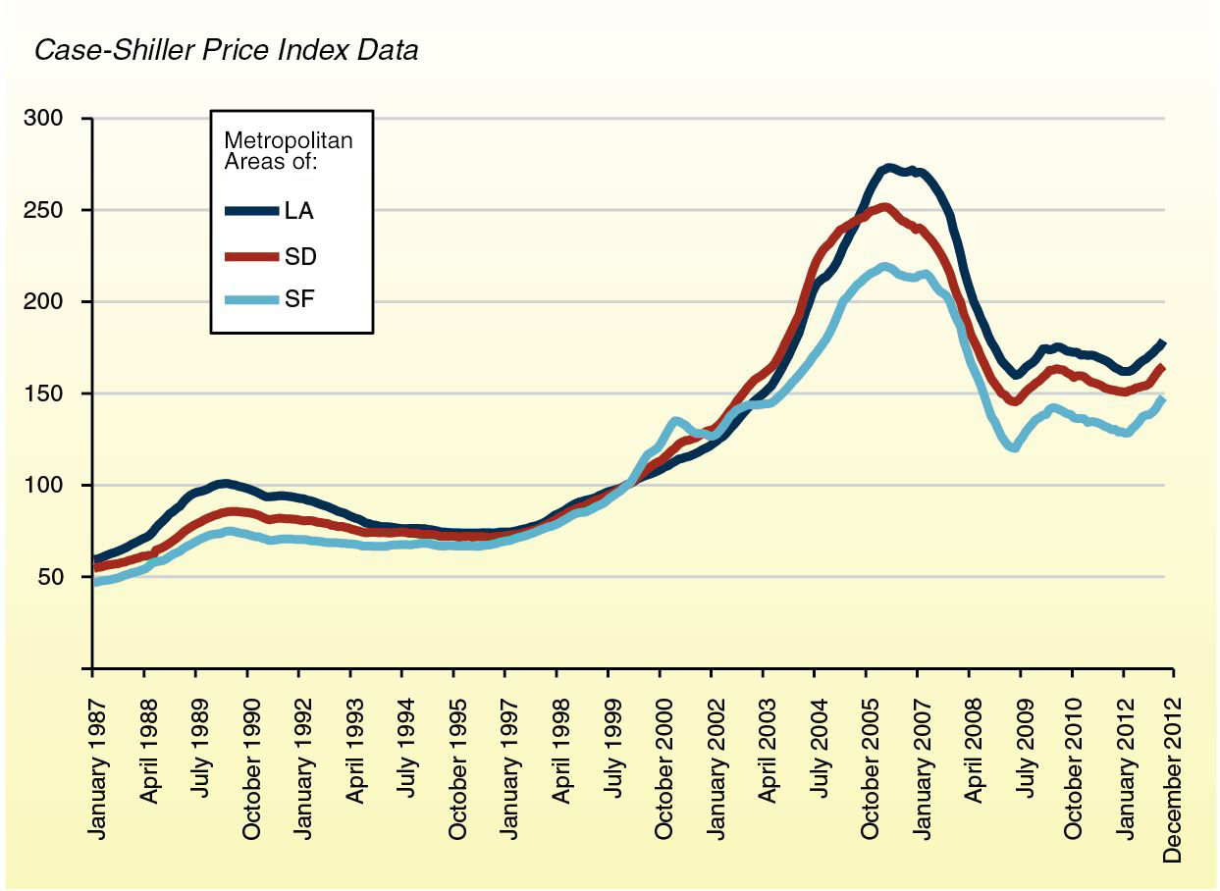
Key Housing Markets Continue to Improve

Slide 14
Revenue Update

Slide 15
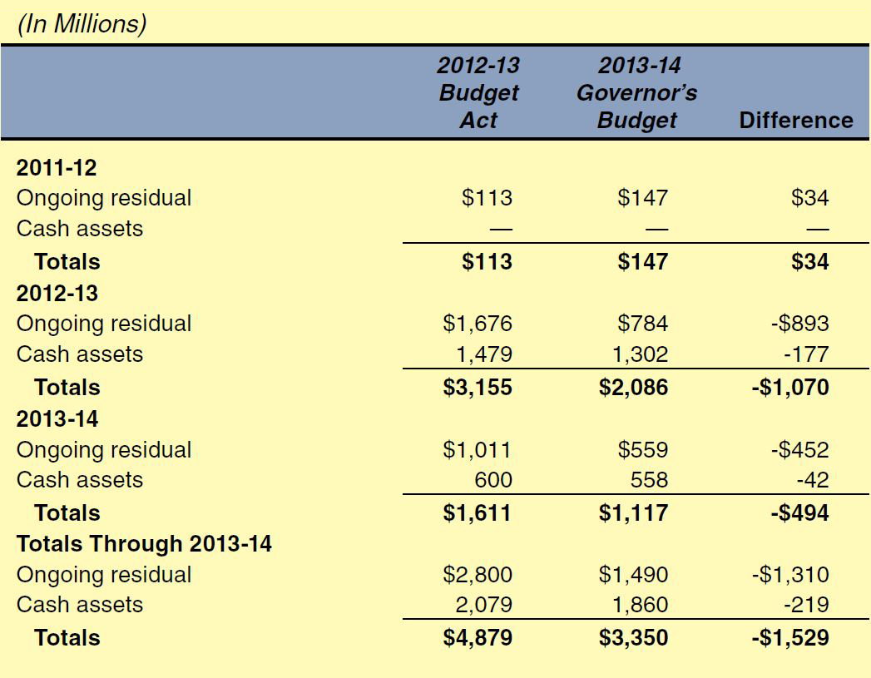
Lower Estimates of Redevelopment-Related Transfers

Slide 16
Administration’s Multiyear “Big Three” Revenue Forecast

Slide 17
State Big Three Revenue Update

Slide 18
Effect of Revenues on Guarantee: Scenario 1
Revenues Up $1.5 Billion Across 3 Years
Up $500 million in 2011-12.
Up $4.2 billion in 2012-13.
Down $3.2 billion in 2013-14.
Guarantee
$57.4 billion, up $3.8 billion, in 2012-13.
$54.4 billion, down $1.8 billion, in 2013-14.

Slide 19
Effect of Revenues on Guarantee: Scenario 2
Revenues Up $4 Billion Across 3 Years
Up $500 million in 2011-12.
Up $3 billion in 2012-13.
Up $500 million in 2013-14.
Guarantee
$56.2 billion, up $2.7 billion, in 2012-13.
$56.5 billion, up $300 million, in 2013-14.

Slide 20
Effect of Revenues on Guarantee: Scenario 3
Revenues Up $7.5 Billion Across 3 Years
Up $600 million in 2011-12.
Up $4.4 billion in 2012-13.
Up $2.5 billion in 2013-14.
Guarantee
$57.6 billion, up $4.0 billion, in 2012-13.
$57.7 billion, up $1.5 billion, in 2013-14.

Slide 21
Federal Update

Slide 22
Sequestration Now in Effect
5 Percent Cut to Most Federal Education Programs
Effective Beginning 2013-14
Title I and IDEA Affected

