Slide 1
California’s Fiscal Outlook
California Association of School Business Officials
November 17, 2016

Slide 2
National and State Economic Outlook

Slide 3
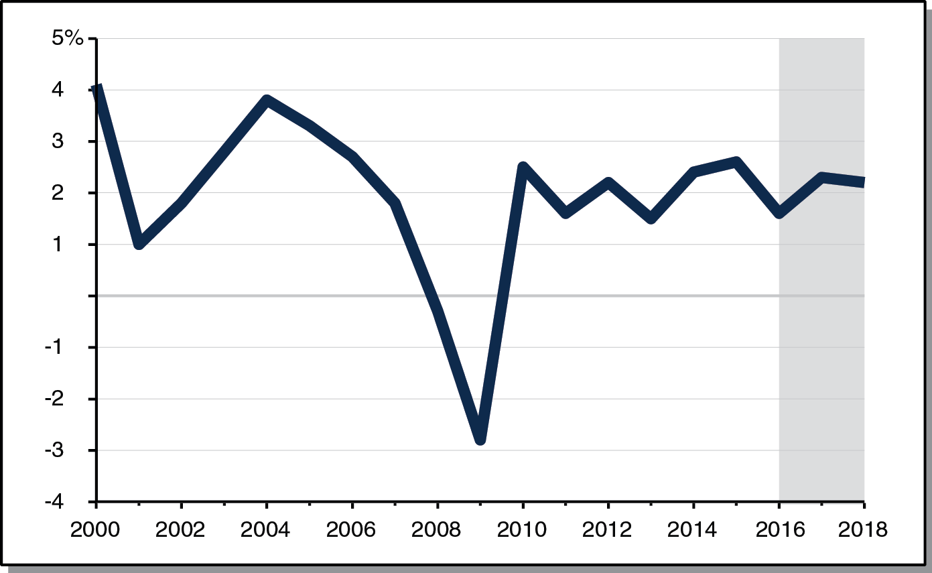
Economic Expansion Assumed to Extend Throughout Forecast Period
Real Gross Domestic Product, Percent Change From Prior Year

Slide 4
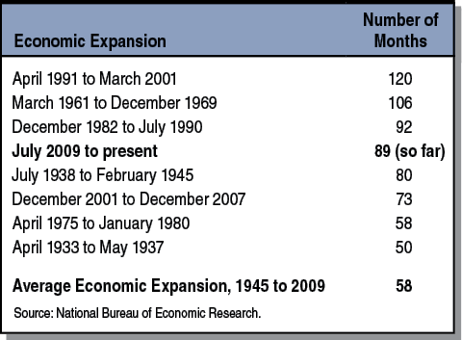
Current Economic Expansion Already Among Longest in U.S. History
Data Since 1984

Slide 5
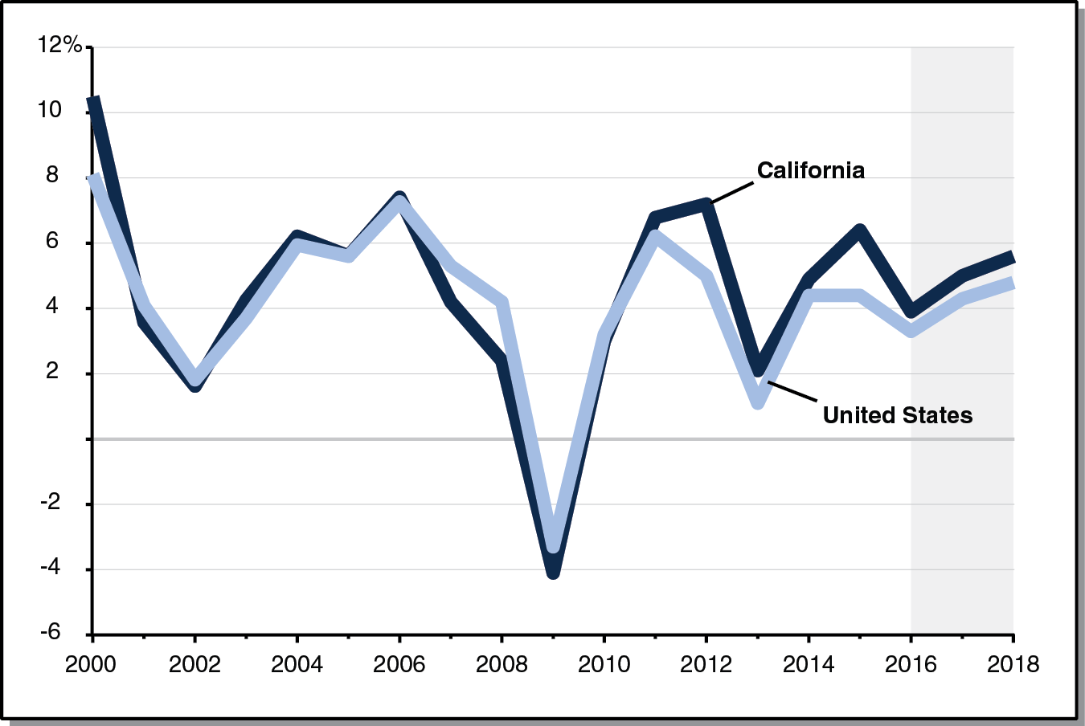
Growth in Personal Income Projected to Be Solid Throughout Forecast Period
Percent Change From Prior Year

Slide 6
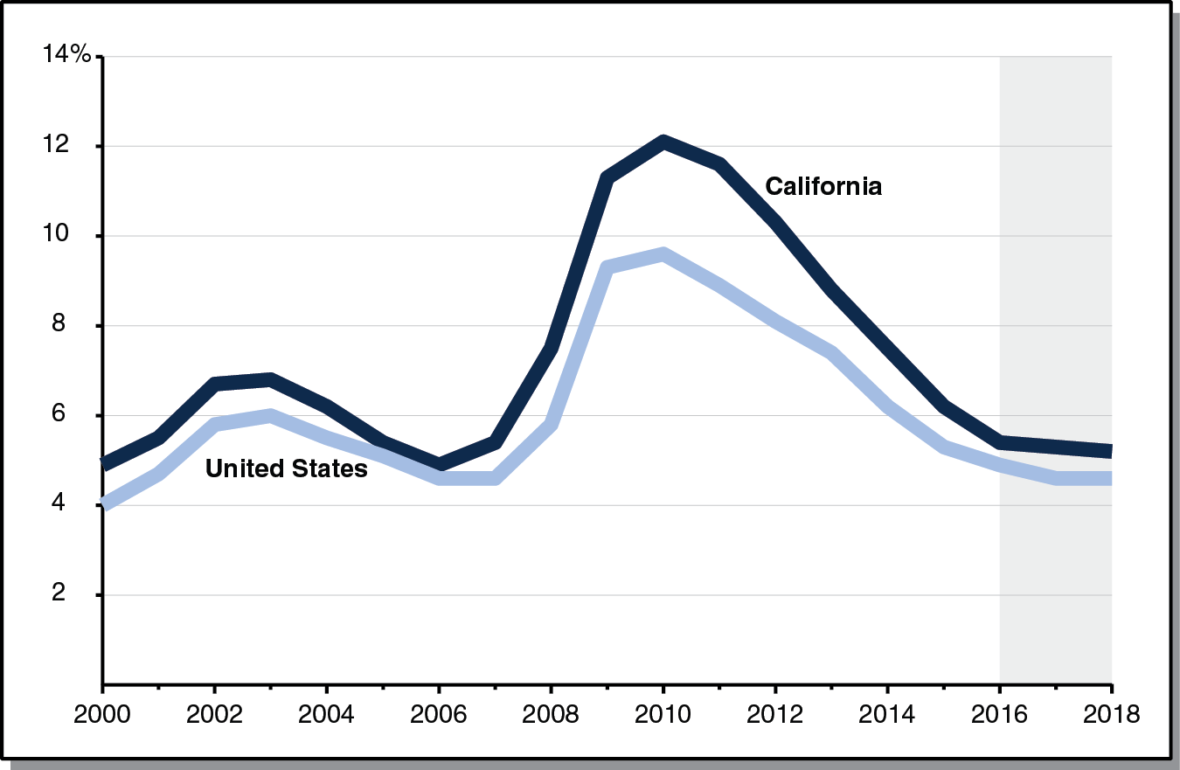
Unemployment Rate Projected to Drop Throughout Forecast Period
Unemployed Workers as a Share of Labor Force

Slide 7
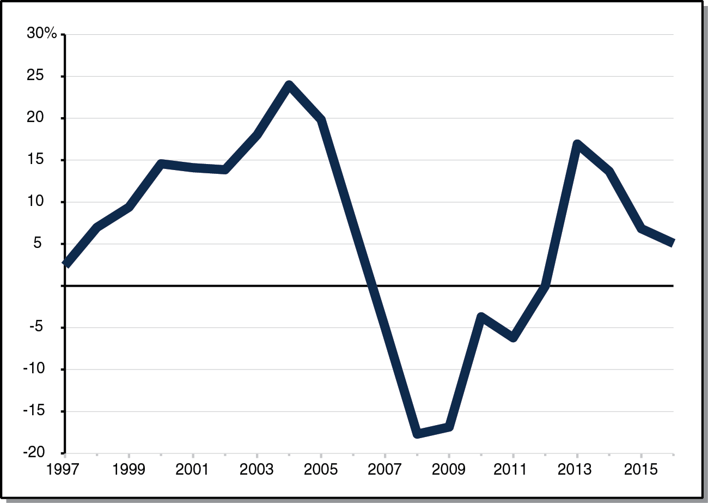
Growth in Home Prices Has Slowed Somewhat in Recent Years
Year-Over-Year Growth in California Home Prices

Slide 8
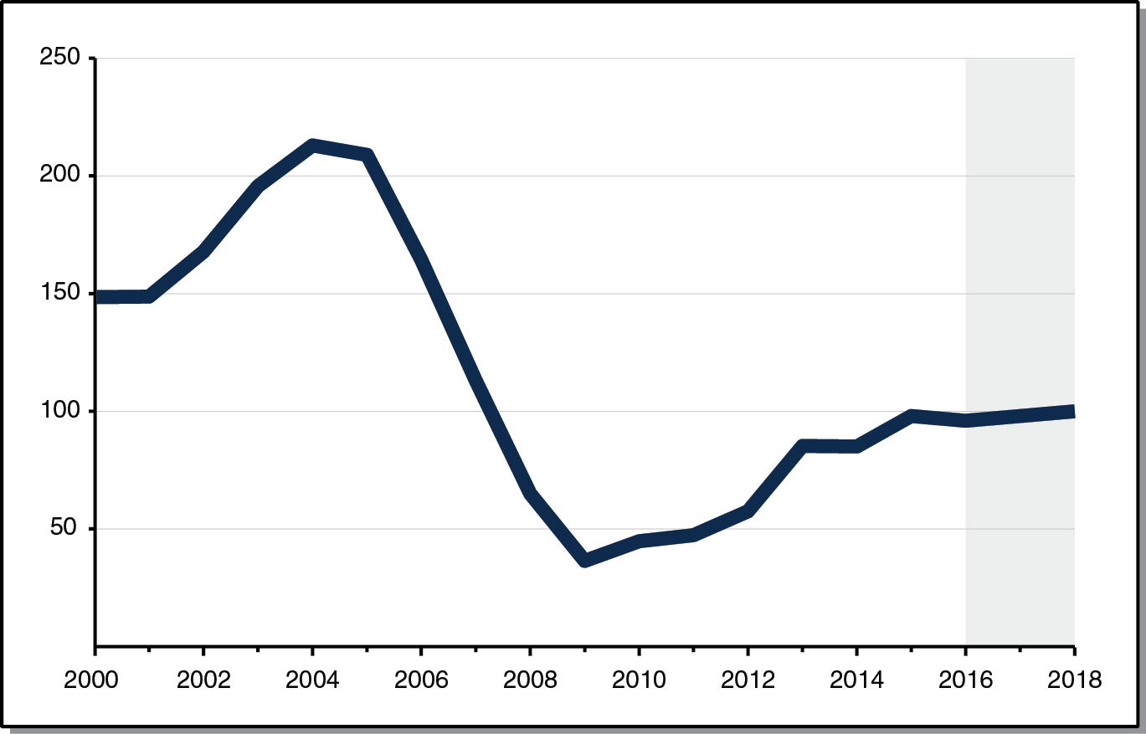
New Housing Permits Projected to Be Virtually Flat Throughout Forecast Period
Permits in Thousands

Slide 9
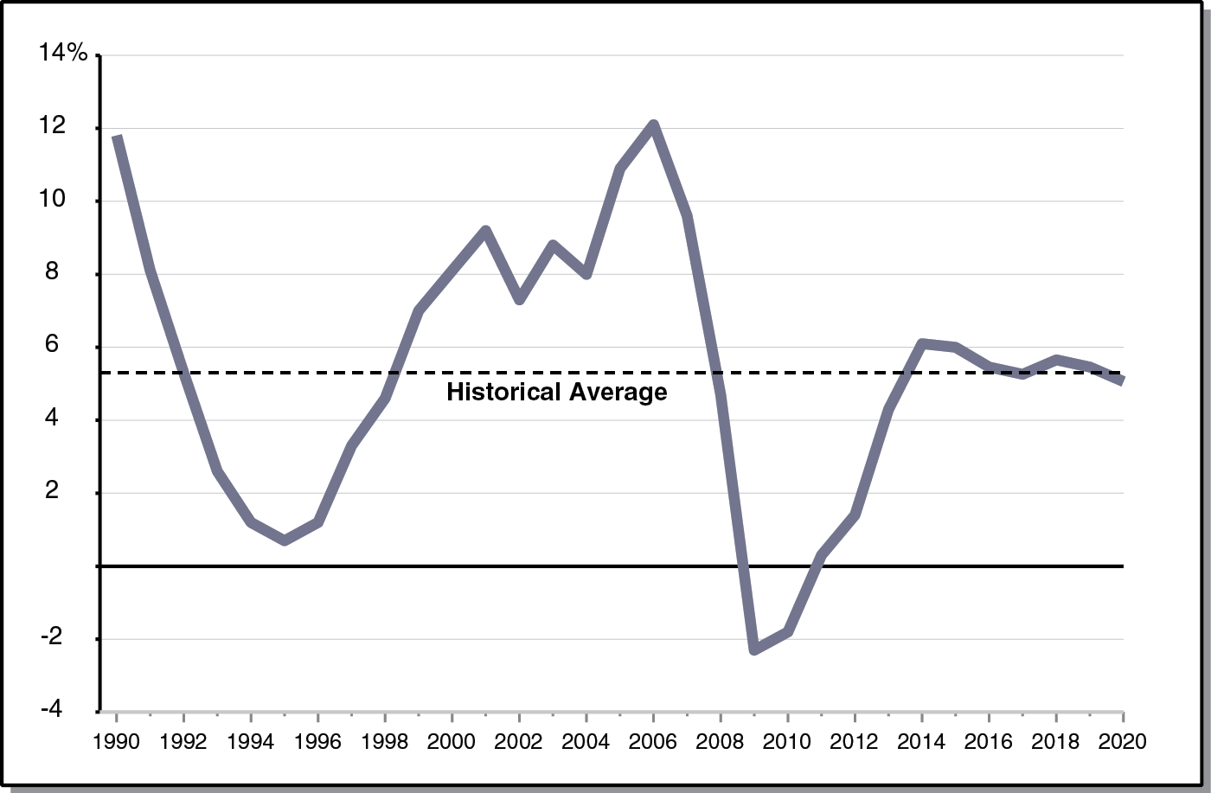
Assessed Property Values at About Historical Average Throughout Forecast Period
Percent Change From Prior Year

Slide 10
State’s Fiscal Outlook Through 2017-18

Slide 11
2016-17 Reserve Revised Down by $1 Billion
LAO Estimates
Revenues Down $1.7 Billion
Expenditures Down $1.2 Billion
Entering Balance Down $510 Million

Slide 12
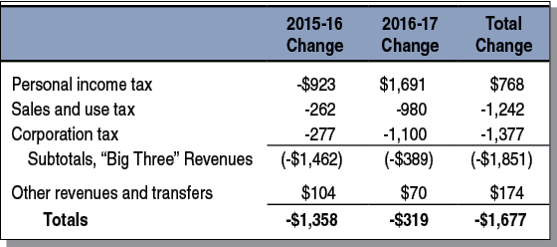
Revenues Down $1.7 Billion From June 2016 Budget Act Assumptions
State General Fund, LAO Projections (Dollars in Millions)

Slide 13
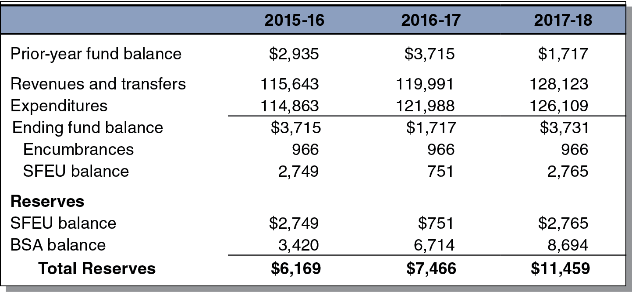
State Projected to End 2017-18 With $11.5 Billion Reserve
State General Fund Condition, LAO Projections (In Millions)

Slide 14
Solid Growth in State Revenues Projected for 2017-18
State General Fund, LAO Projections (Dollars in Millions)

Slide 15
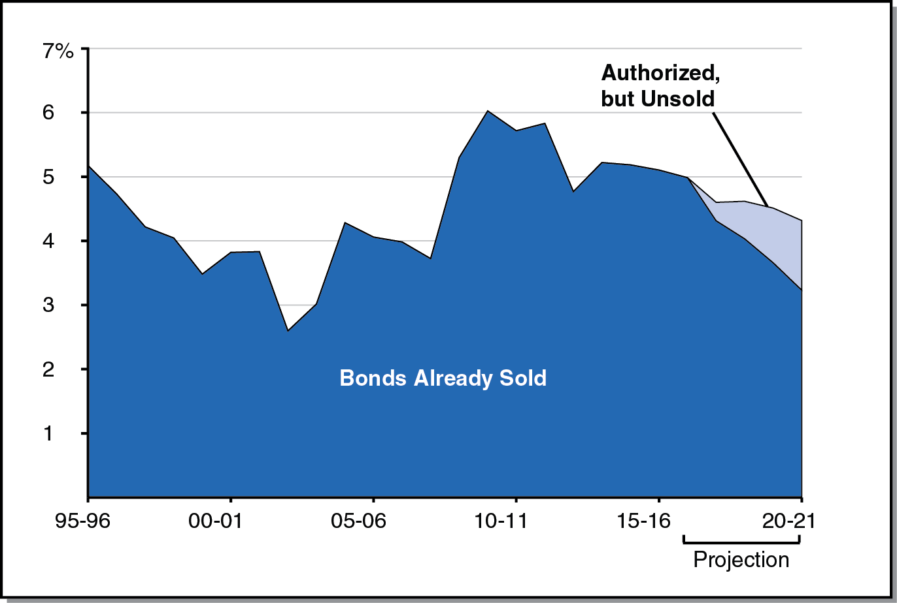
Debt Service Ratio Expected to Decline Somewhat Throughout Forecast Period
Debt Service Costs as Share of Annual General Fund Revenues, LAO Projections

Slide 16
Education Outlook Through 2017-18

Slide 17
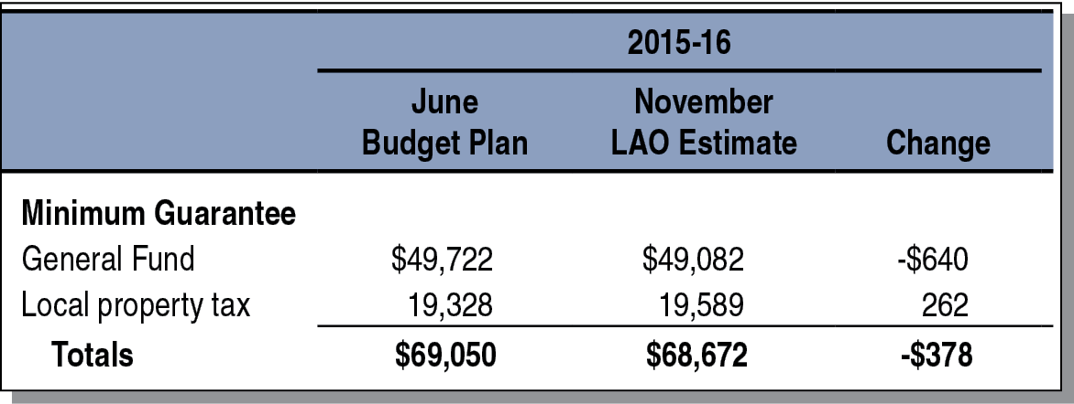
2015-16 Minimum Guarantee Slightly Down From June Budget Act Estimates
(In Millions)

Slide 18
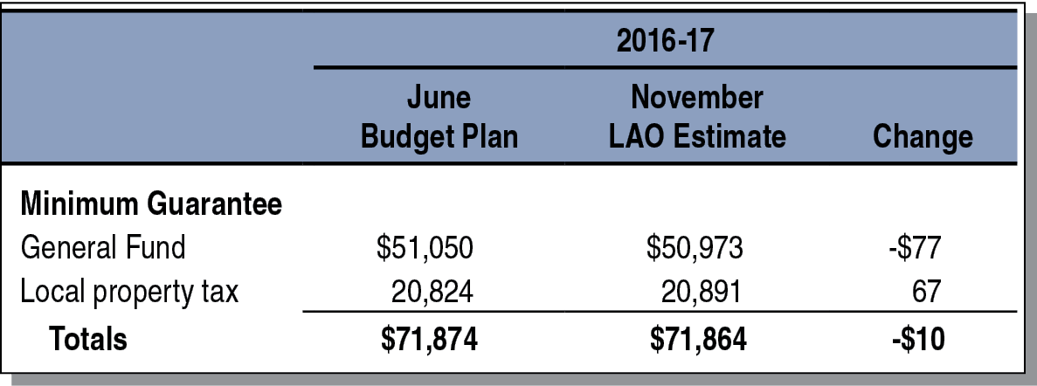
2016-17 Minimum Guarantee Virtually Unchanged From June Budget Act Estimates
(In Millions)

Slide 19
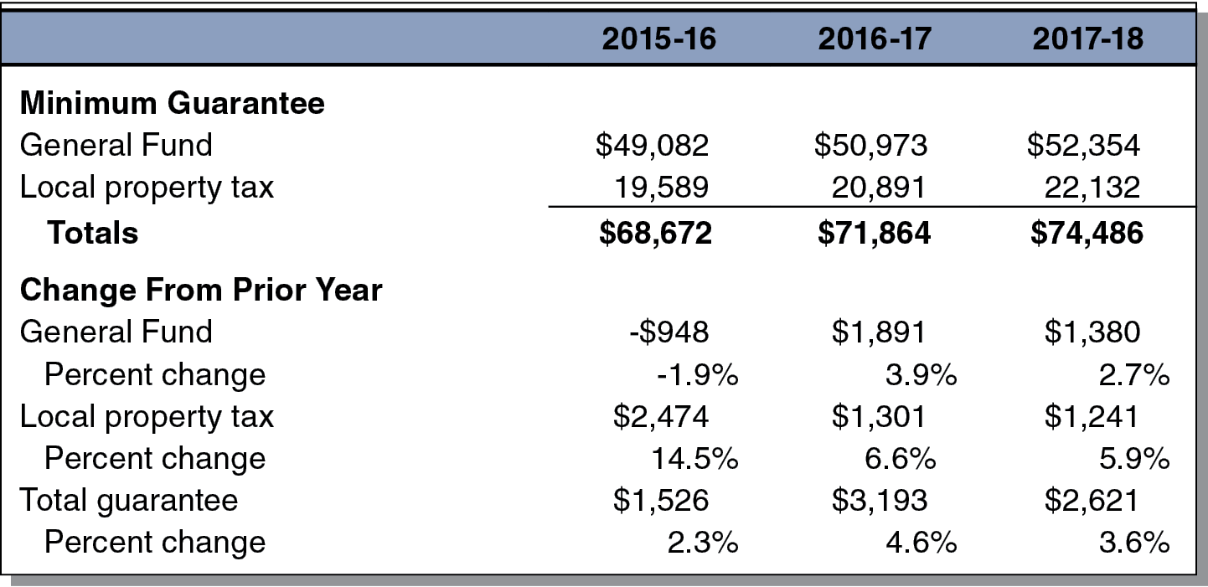
Proposition 98 Minimum Guarantee Projected to Grow Steadily Through 2017-18
LAO Projections (Dollars in Millions)

Slide 20
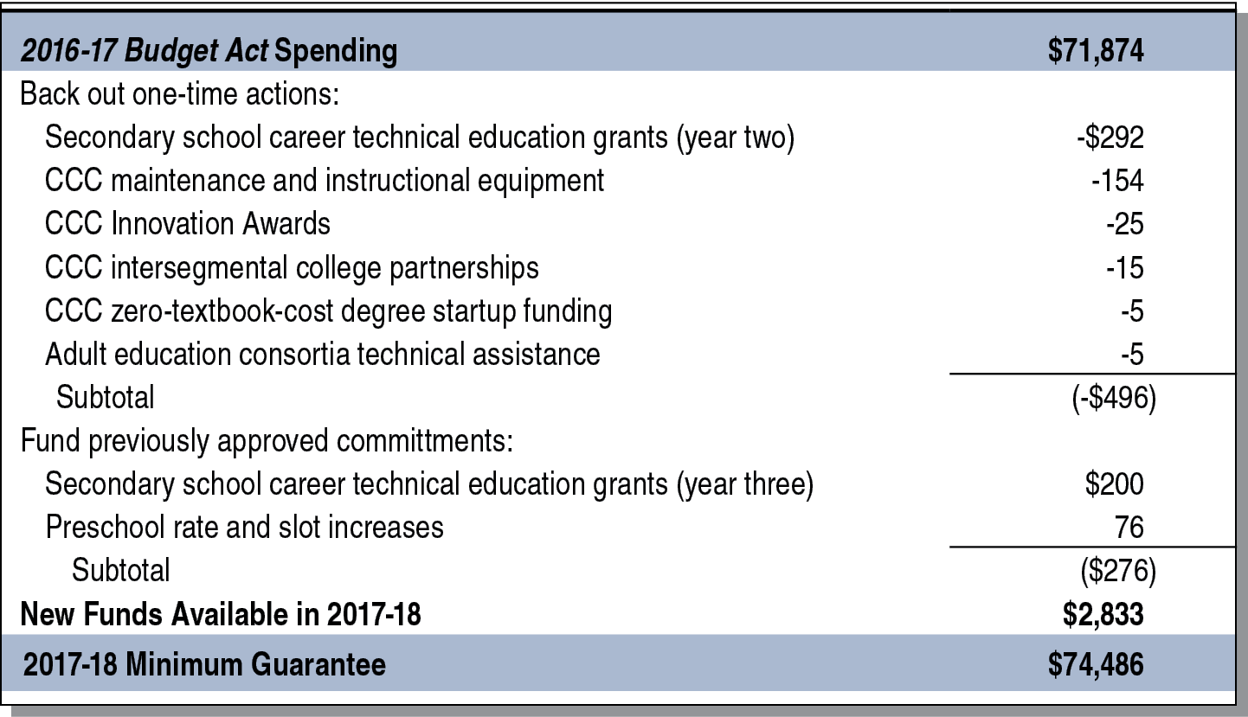
$2.8 Billion in Additional Funding Available for Proposition 98 Priorities in 2017-18
LAO Projections (In Millions)

Slide 21
State’s Fiscal Outlook Through 2020-21

Slide 22
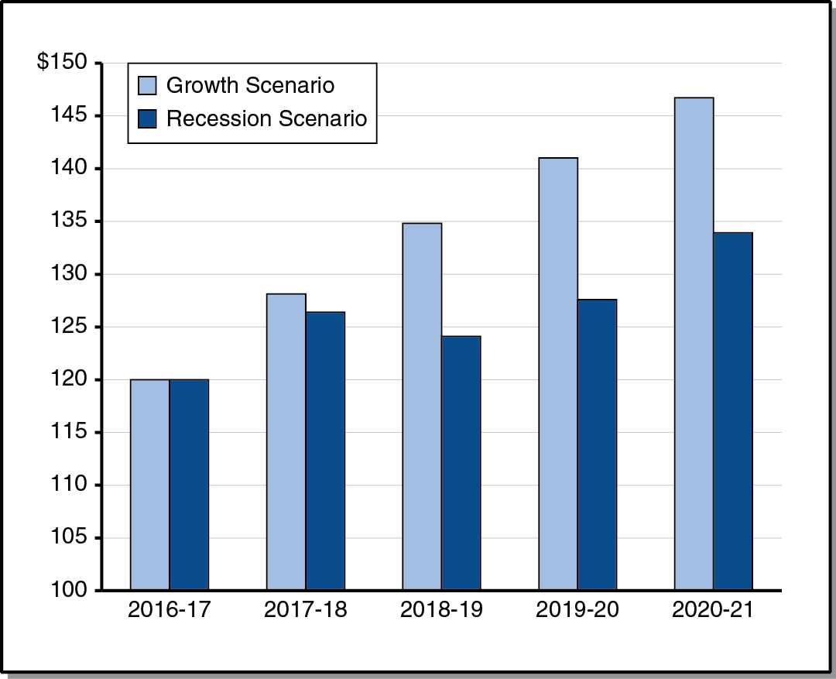
Comparing State Revenues Under Two Economic Scenarios
LAO Projections (In Billions)

Slide 23
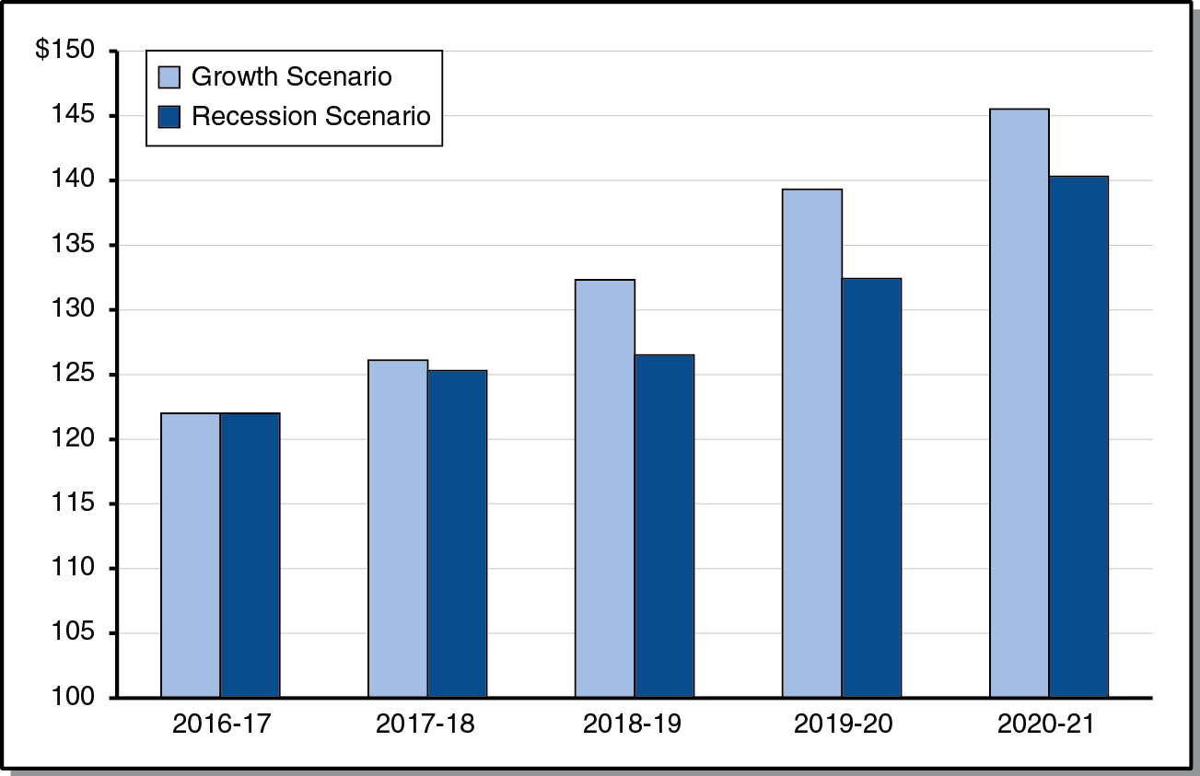
Comparing State Spending Under Two Economic Scenarios
LAO Projections (In Billions)

Slide 24
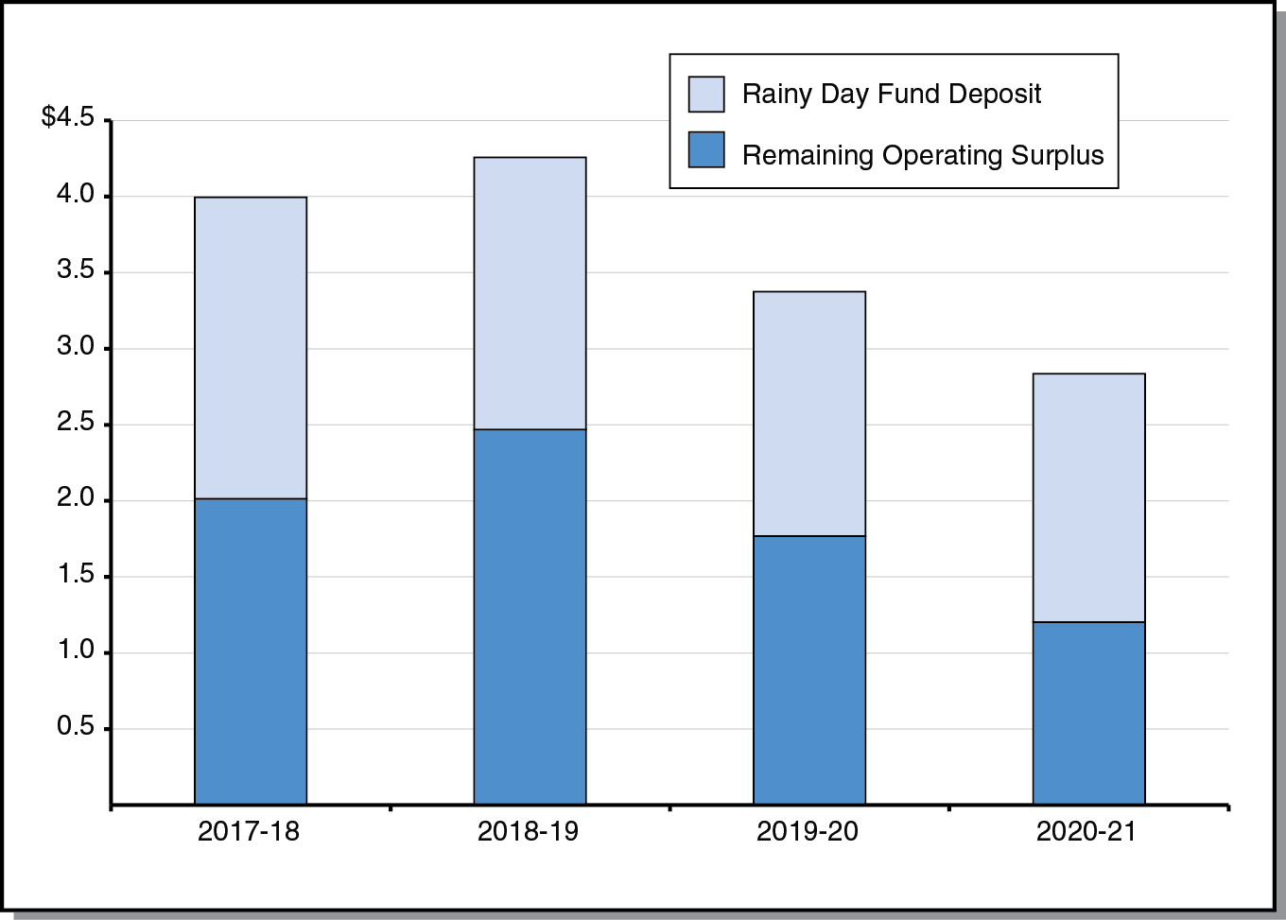
General Fund Surpluses and Reserve Deposits Under Economic Growth Scenario
LAO Projections (In Billions)

Slide 25
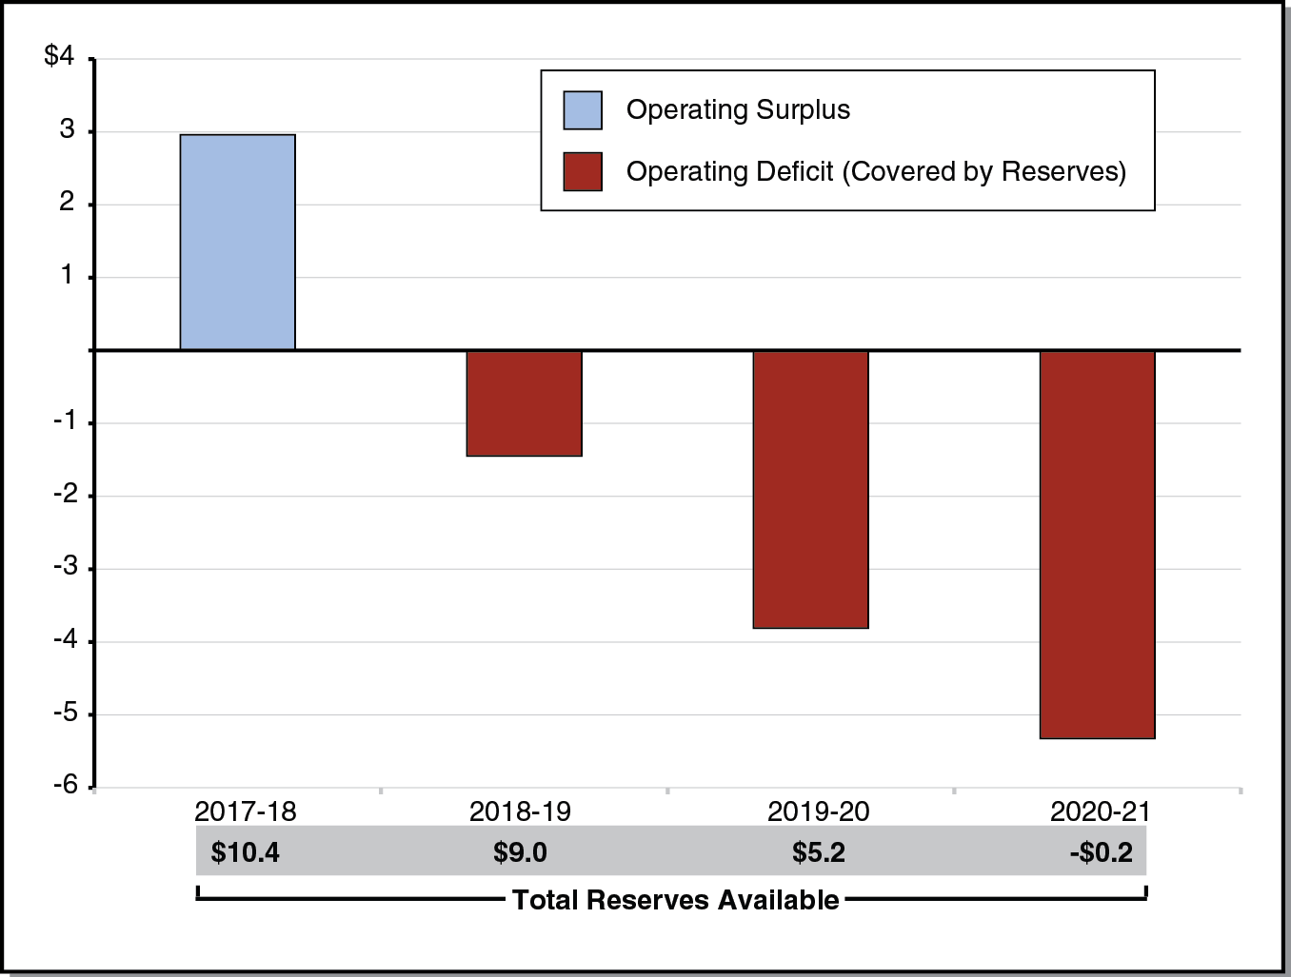
Reserve Covers Operating Deficits in Mild Recession Scenario
LAO Projections (In Billions)

Slide 26
Education Outlook Through 2020-21

Slide 27
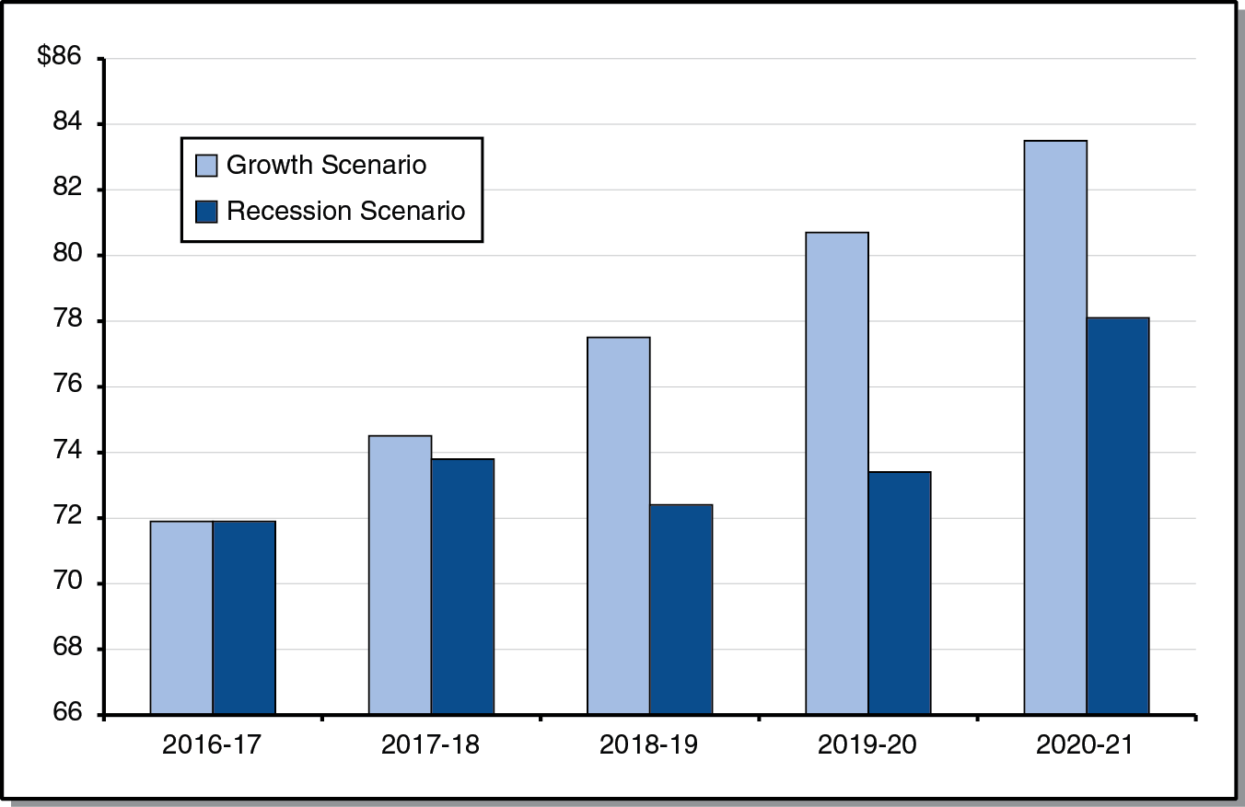
Comparing Minimum Guarantee Under Two Economic Scenarios
LAO Projections (In Billions)

Slide 28
Other Outlook Factors
LAO Projections
Property Tax Revenue Projected to Rise Steadily
K-12 COLA Projected to Remain Low
K-12 Attendance Projected to Decline
Projected Pace of LCFF Implementation Varies by Scenario

Slide 29
Pension Costs
LAO Projections
$6 Billion Higher Costs
Reflects One-Quarter of New Proposition 98 Funding Under Growth Scenario
Reflects One-Third of New Proposition 98 Funding Under Recession Scenario

